Slide 1

Extra Exercises On ER Diagram
CSC380

Slide 2
1. Identify the entities and relationships and draw an E-R diagram.
Departments, identified by ID, operate a variety of printers, each located in a particular room in a particular building. Printers are supplied by a number of suppliers, identified by name, with each supplier charging a different price for a given printer, but also providing different delivery delays, measured in days. A given room can have any number of printers, including none.

Slide 3
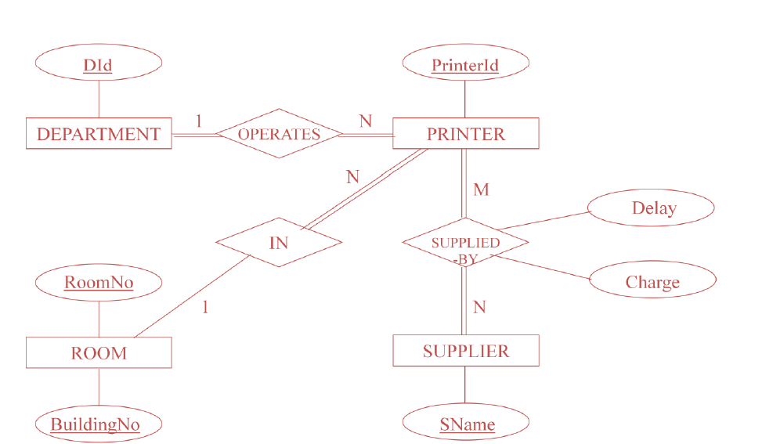

Slide 4
2. A chain of pharmacies has offered to give you a free lifetime supply of medicine if you design its database. Given the rising cost of health care, you agree. Here’s the information that you gather:
Patients are identified by an SSN, and their names, addresses, and ages must be recorded.
Doctors are identified by an SSN. For each doctor, the name, specialty, and years of experience must be recorded.
Each pharmaceutical company is identified by name and has a phone number.
For each drug, the trade name and formula must be recorded. Each drug is made by a given pharmaceutical company, and the trade name identifies a drug uniquely from among the products of that company. If a pharmaceutical company is deleted, you need not keep track of its products any longer.

Slide 5
2. A chain of pharmacies has offered to give you a free lifetime supply of medicine if you design its database. Given the rising cost of health care, you agree. Here’s the information that you gather:
Each pharmacy has a name, address, and phone number.
Every patient comes to his Doctor. Every doctor has at least one patient.
Each pharmacy sells several drugs and has a price for each. A drug could be sold at several pharmacies, and the price could vary from one pharmacy to another.
Doctors prescribe drugs for patients. A doctor could prescribe one or more drugs for several patients, and a patient could obtain prescriptions from several doctors. Each prescription has a date and a quantity associated with it. You can assume that, if a doctor prescribes the same drug for the same patient more than once, only the last such prescription needs to be stored.

Slide 6
2. A chain of pharmacies has offered to give you a free lifetime supply of medicine if you design its database. Given the rising cost of health care, you agree. Here’s the information that you gather:
Pharmaceutical companies have long-term contracts with pharmacies. A pharmaceutical company can contract with several pharmacies, and a pharmacy can contract with several pharmaceutical companies. For each contract, you have to store a start date, an end date, and the text of the contract.
Pharmacies appoint a supervisor for each contract. There must always be a supervisor for each contract, but the contract supervisor can change over the lifetime of the contract.
Draw an ER diagram that captures the information about the chain of pharmacies. Underline primary keys and show the total participation.

Slide 7
Age
Name
Address
Ssn
Name
Speciality
M
VISIT
N
DOCTOR
PATIENT
Ssn
M
EYear
N
PRESCRIBE
Date
Name
PhoneNo
Address
Quantity
K
N
SELL
M
PHARMACY
DRUG
Trade name
M
Formula
M
Price
MADE
BY
Sdate
CONTRACT
Name
1
Edate
N
PHARM_CO
PhoneNum
Text
Supervisor

Slide 8
Questions?

